Slide 1

Data Science Certification

Slide 2
Module 8
Gradient Boosting

Slide 3
Introduction to Boosting Techniques
Types of Boosting Techniques
Need for Gradient Boosting
Introduction to Gradient Boosting
Components of Gradient Boosting
Working of Gradient Boosting
Applications
Limitations of Gradient Boosting

Slide 4
Introduction to Boosting Techniques

Slide 5
Introduction to Boosting Techniques
Boosting is an ensemble learning technique where weak learners are trained sequentially.
Each weak learner corrects the errors of the previous one.
This way, subsequent weak learners focus more on correcting the mistakes made earlier, gradually improving the model's overall performance.
The boosting technique can be resembled with a child who is learning over time from his own mistakes.
Data Set
Data Set
Weak Model
Initial Predictions
Updated Data
Weak
Model
Initial Predictions
Updated Data
Weak
Model
Final Predictions

Slide 6
Types of Boosting Techniques

Slide 7

Types of Boosting Techniques
Gradient Boost
Stochastic
Gradient Boost(SGBoost)
It is an ensemble method, where weak learners (typically decision trees) are sequentially trained to correct errors made by the previous ones
It is a variation of gradient boosting that introduces randomness , thus enhancing diversity and improving generalization.
Extreme Gradient Boost (XGBoost)
Adaptive Boost(AdaBoost)
It is an updated version of gradient boosting with additional features like parallel processing, regularization, and handling missing values.
It is an ensemble method where weak learners are iteratively trained, assigning higher weights to misclassified instances, and combining their predictions to create a strong ensemble.

Slide 8
Need of Gradient Boosting

Slide 9
Need of Gradient Boosting
Ability to Handle Large Datasets
Gradient Boosting can still handle large datasets efficiently. It may require more computation for processing large datasets, but it still provides results with high accuracy.
Deals with Overfitting
Gradient Boosting deals with overfitting by introducing Regularization techniques. It has built-in support for regularization techniques like L1 and L2, which prevent overfitting.
Handling Complex Relationships
Gradient boosting is effective at capturing complex relationships between features and the target variable.
01
02
03

Slide 10
Introduction to Gradient Boosting

Slide 11
Introduction to Gradient Boosting
Gradient boosting is a boosting machine learning algorithm that sequentially builds models to minimize prediction errors by emphasizing previously misclassified data.
01
In the world of machine learning, Gradient Boosting is like a teamwork approach. It combines weak models to create a strong one by fixing mistakes step by step. It's like a team that learns from each other, making accurate predictions in the end.
02

Slide 12

Components
of Gradient Boosting

Slide 13
Components of Gradient Boosting
Weak Learners
Additive Model
Loss Function
Weights of Weak Learners
1
3
2
4
Simple workers in the team.
A powerful team is formed by the combination individual players.
The coach is guiding the team to minimize mistakes.
How much each player is contributing to the team.

Slide 14

Weak Learners
Weak Learners:
Weak learners are basic models that individually may not perform well, but when combined, they contribute to a strong predictive model.
Regression Trees: Simple models that make rough numerical predictions.
Classification Trees: Simple models that make rough categorical predictions.
Illustration of Errors and Iterations

Slide 15
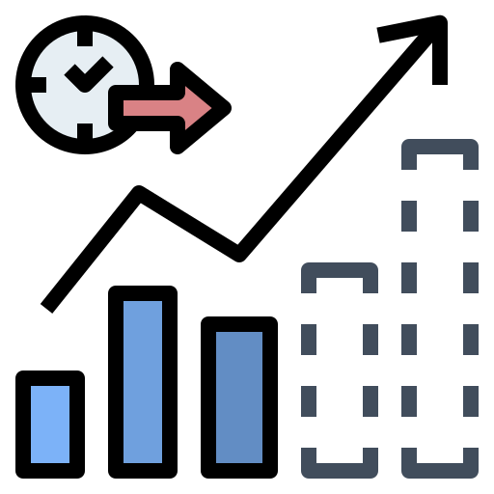
Additive Model
The term "additive model" refers to the way individual weak learners, or models, are combined to create a stronger predictive model. The idea is that instead of constructing a single powerful model, Gradient Boosting builds a series of simpler models sequentially, with each new model focused on correcting the errors of the combined ensemble so far.
In Gradient Boosting, the additive model is like leveling up your prediction game. You start with a basic prediction, and then each new player (weak learner) you add corrects the mistakes of the team before. It's like refining your strategy after each game, making the overall team stronger.
Illustration of Errors and Iterations

Slide 16
Loss Function
The loss function plays a crucial role as it quantifies the difference between the predicted values and the actual target values.
The primary objective during the iterative process of building the ensemble is to minimize this loss function.
The loss function is like a coach assessing how far off our predictions are from the actual scores. It guides the team (models) to play better in the next game (iteration). The goal is to minimize the difference between our predictions and the actual outcomes.

Slide 17
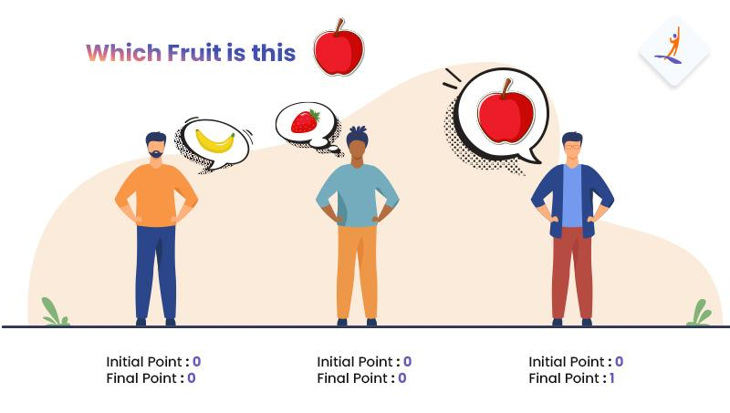
Weights of Weak Learners
Each weak learner in the ensemble is assigned a weight that determines its contribution to the final prediction. Weak learners that perform well are given higher weights, while underperforming ones are given lower weights. This weighting ensures that more accurate models have a greater influence on the final prediction. Weights are like how much contribution each player is making in the final game.

Slide 18
Working of XGBoost
Update the Model
Final Prediction
Initialization
1
3
5
2
4
Fit a Base Model
Repeat Steps 2 -3

Slide 19
Working of
Gradient Boosting

Slide 20
Working of Gradient Boosting
Initialization
Start with a simple prediction, often just the average value of all target outcomes.
Fit a Base Learner
Fit a weak learner (often a decision tree) to predict the residual errors from the previous step. Residual errors are the difference between actual values and predicted values.
01
02

Slide 21
Working of Gradient Boosting
Update the Model
Adjust the initial prediction by adding a fraction of the predictions from the weak model to it. In simple words, it learns from previous mistakes and updates itself.
Repeat
Repeat steps 2 and 3 several times, each time training a new weak model to correct the errors left by the combined predictions of all previous models. Repetitions are done until a certain stopping condition is met.
03
04

Slide 22

Working of Gradient Boosting
Final Prediction
Combine the predictions from all the weak models to make a final prediction. The combined prediction is more accurate than the prediction made by any individual weak model.
05

Slide 23
Applications

Slide 24
Applications
E-commerce
E-commerce platforms use it to provide personalized recommendations to users based on their past interactions and behaviors.
Credit Scoring
Assessing the creditworthiness of individuals based on available information.
01
03
02
04
Customer Churn Prediction
Predicting customer attrition in the telecommunications and subscription-based services industries.
Healthcare Analytics
Predicting the presence or absence of a medical condition based on symptoms and test results.

Slide 25
Hands-On: Census Income Hands-On
© Copyright Intellipaat. All rights reserved.

